Slide 1

.NET Bootcamp

Slide 2
Overview
Databases and Data Modeling
SQL
For next class

Slide 3
Databases
Databases are collection of information and data
Types of Databases
Relational Databases (SQL)
Key-Value Stores (NoSQL)
Document Stores (NoSQL)
Graph Databases
Many more

Slide 4
Relational Databases
Structured collection of data with associations between collections
Collections of data are typical modeled as database tables
Rows in a table represent a record of a data point
Columns in a table represent the fields or attributes of each record
Typically each column is constrained to a single data type

Slide 5
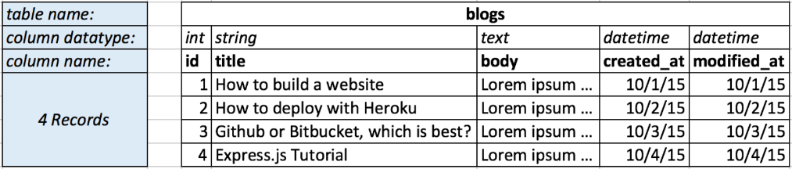
Database Tables
Here is an example database table for a blog:

Slide 6
Database Tables
id: convention for every table to have an id column. Each record should have a unique id value

Slide 7
Database Tables
created_at and modified_at : convention for every table to have these columns to track creation time and last edit time
User information can additionally be stored for auditing purposes

Slide 8
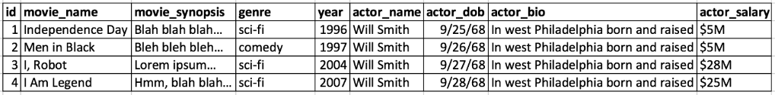
Movies Database Table
Does this look ok? Are there any problems?

Slide 9
Movies Database Table
Concerns:
Data Redundancy
A lot of data taking up storage
Data Integrity
What if “Will Smith” is misspelled as “Will Smyth” in 1 or more entries?
What if the bio has to be updated?

Slide 10
Data Modeling
Database Normalization is the design of the database tables and columns to reduce redundancy and maintain data integrity

Slide 11
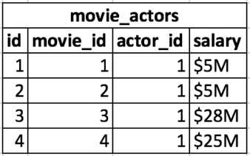
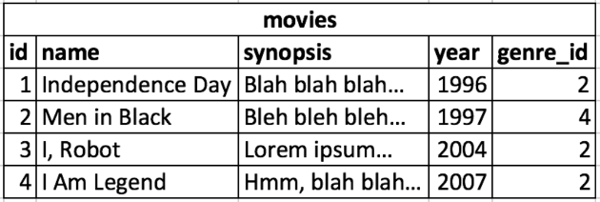
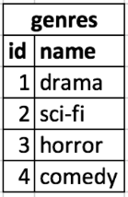
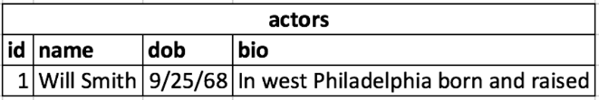
Movies Database Table Updated

Slide 12
Database Normalization
How Normalized data is better:
Add actors to a movie without duplication movie information
Update an actor’s bio once without having to update multiple movies
When adding a movie, don’t have to enter data for actors that are already in the database

Slide 13
Database Normalization
How Normalized data is more complicated:
How do you determine the genre name for a given movie?
How do you lookup all the movies for a given actor?
How do you find all the actors for a given movie
How do you determine all the genres an actor has worked in?

Slide 14
SQL
Finding answers to data questions require looking at multiple tables
SQL – Structured Query Language – is a declarative programming language designed to facilitate querying normalized data
Helps follow the relation in the database tables

Slide 15
SQL Relations and Associations
Columns such as movies.genre_id, movie_actors.movie_id, and movie_actors.actor_id produce relations amount the records

Slide 16
SQL Relations and Associations
Three types of record associations:
1 to 1 (1:1)
1 to many (1:n)
Many to many (n:n)

Slide 17
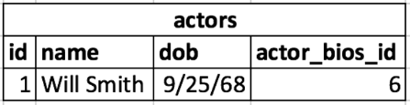
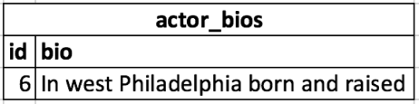
1 to 1 Associations
Looking at the movie dataset, the actor table could be split into two tables, an actor and an actor_bio table
Each actor has one (and only one) actor_bio
This is useful when one table has many fields, but many are less frequently used then others
The split is done for query performance

Slide 18
1 to Many Associations
Each genre has many movies
Each movies belongs to a single genre

Slide 19
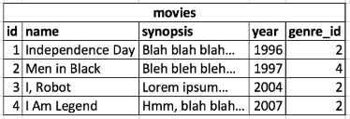
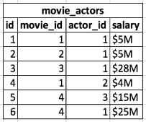
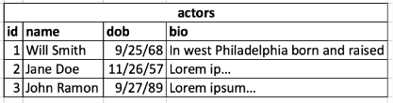
Many to Many Associations
Each movie has many actors through movie_actors
Each actors has many movies through movie_actors

Slide 20
Data Modeling
A visual way to model tables and relationships is using Entity-Relations (ER) Diagrams
Each table is modeled as an object and the relations are arrows

Slide 21
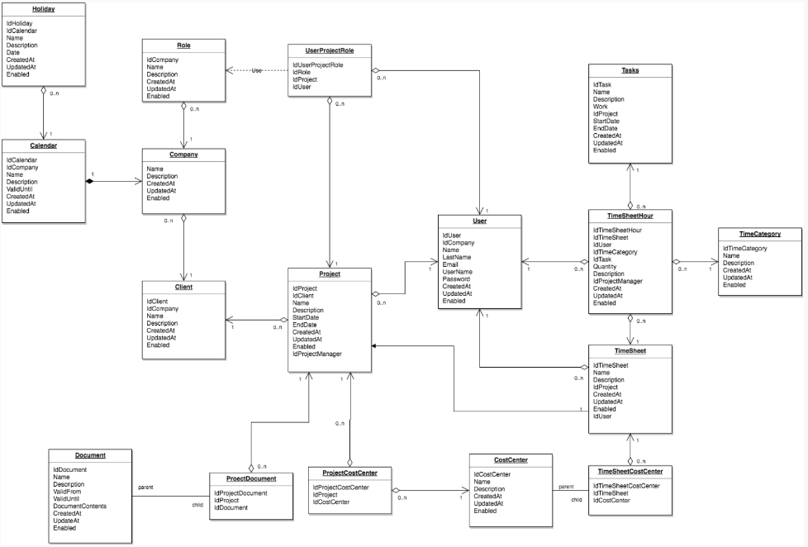
ER Diagram

Slide 22
SQL - Insert
INSERT INTO <TABLE_NAME> (<COLUMNS>,…,…) VALUES(<VALUES>,…,…)
INSERT INTO Movies (name, synopsis, year, genre_id) (‘Suicide Squad’, ‘A terrible movie’, 2016, 3)

Slide 23
SQL - Update
UPDATE <TABLE_NAME> SET <COLUMN> = <VALUE>, … WHERE <CONDITION>
UPDATE Movies SET genre_id = 2 WHERE name = ‘Suicide Squad’

Slide 24
SQL - Select
SELECT <COLUMNS>,…,… FROM <TABLE_NAME> WHERE <CONDITION>
SELECT id, name, synopsis, year FROM Movies WHERE name = ‘Suicide Squad’

Slide 25
SQL - Delete
DELETE FROM <TABLE_NAME> WHERE <CONDITION>
DELETE FROM Movies WHERE name = ‘Suicide Squad’

Slide 26
Further Reading
Introduction to SQL
https://cs.lmu.edu/~ray/notes/introsql/
Codd’s 12 Rules
https://www.tutorialspoint.com/dbms/dbms_codds_rules.htm
Database Normalization
https://en.wikipedia.org/wiki/Database_normalization
https://www.tutorialspoint.com/dbms/database_normalization.htm

Slide 27
For Next Class
Continue to break down your application into manageable tasks and create issues in GitHub
Movie Review Data Modeling Exercise
https://github.com/dotnet-bootcamp/week-9-project

